Slide 1
Senior Project Face recognition-based attendance system for primary school and kindergarten kids
By: Reema Al Harbi U17100706
Khuloud Khalid U18105068
Supervisor: Dr Ibrahim Abaker
Examiner: Dr Ahmed Khedr

Slide 2
Table of Contents
Introduction
Motivation
Project Summary
Project Details
Implementation
Attendance System
Database Set Up
User Interface
Facial Recognition Set Up
Code examples
Conclusion
References

Slide 3


Introduction

Slide 4

Motivation

Slide 5
Project Summary
The main objective of this project is to provide a system based on Face Recognition (FR) technology.

Slide 6




System Enviroment

Slide 7
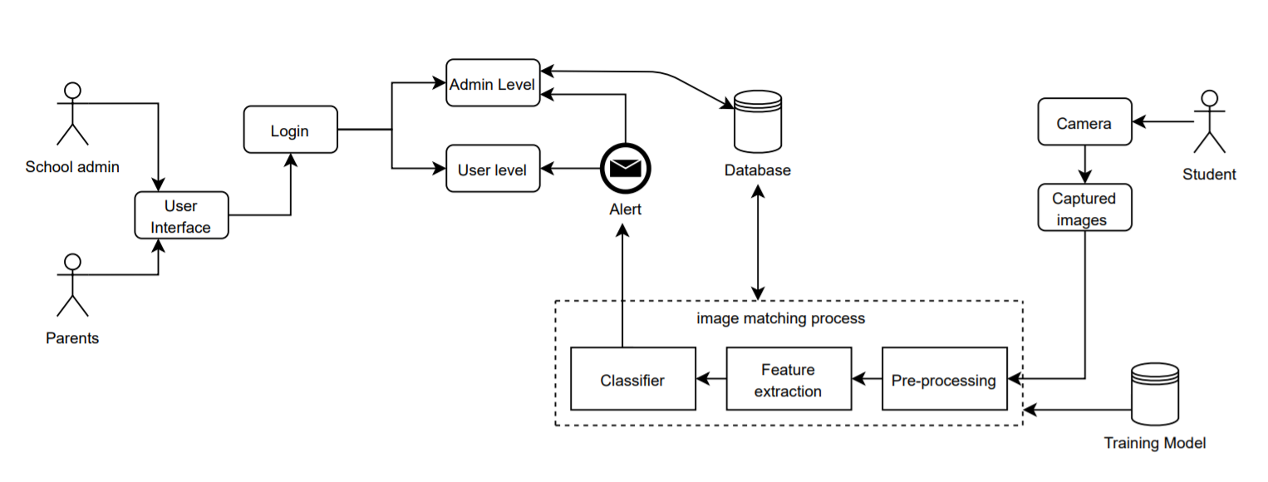
Software Architecture and design

Slide 8
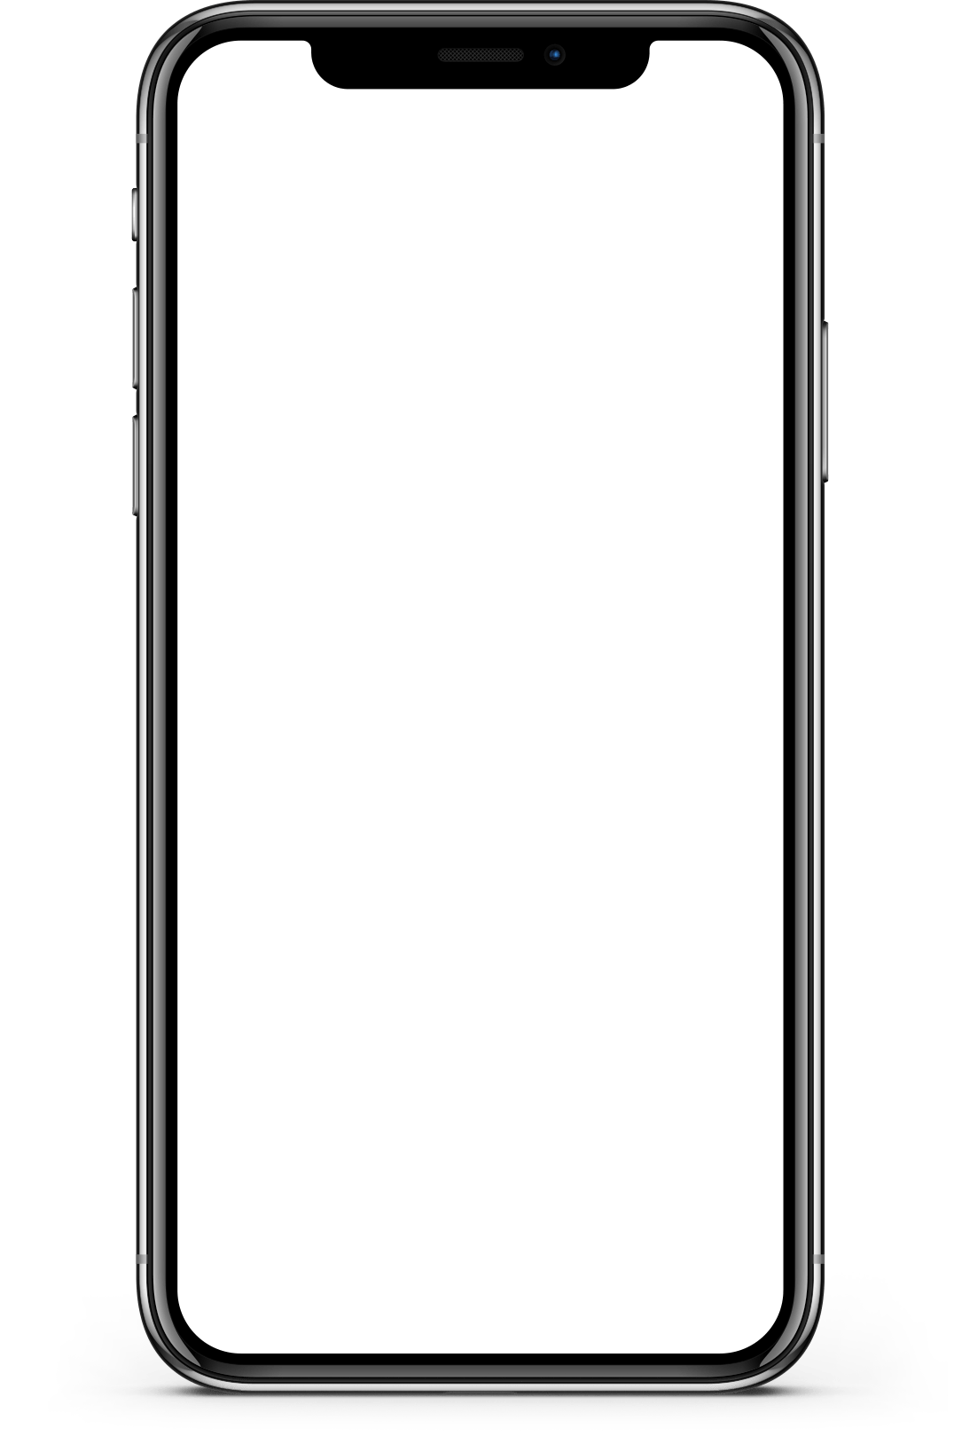



Architecture Components
Device
Camera
Database
User

Slide 9
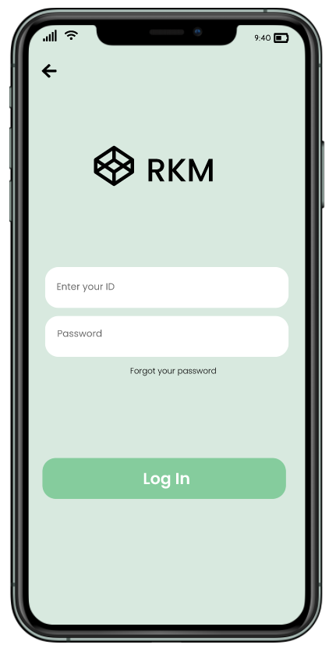
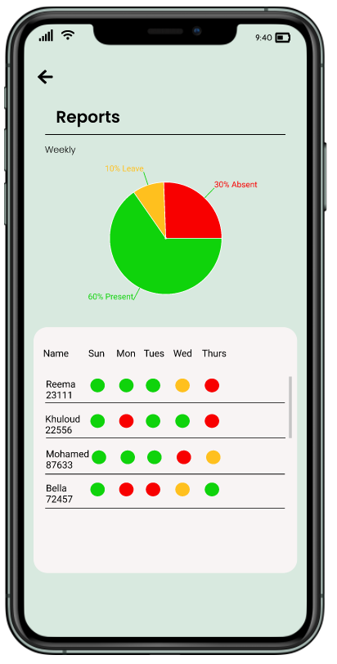
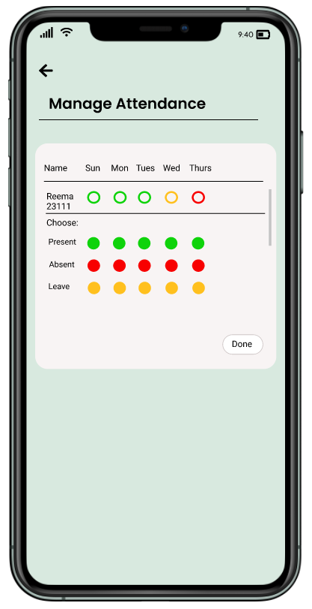
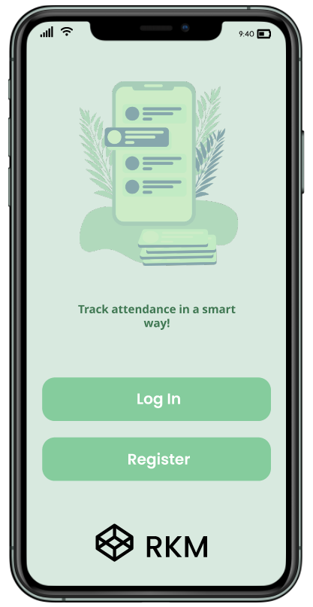
Prototype

Slide 10
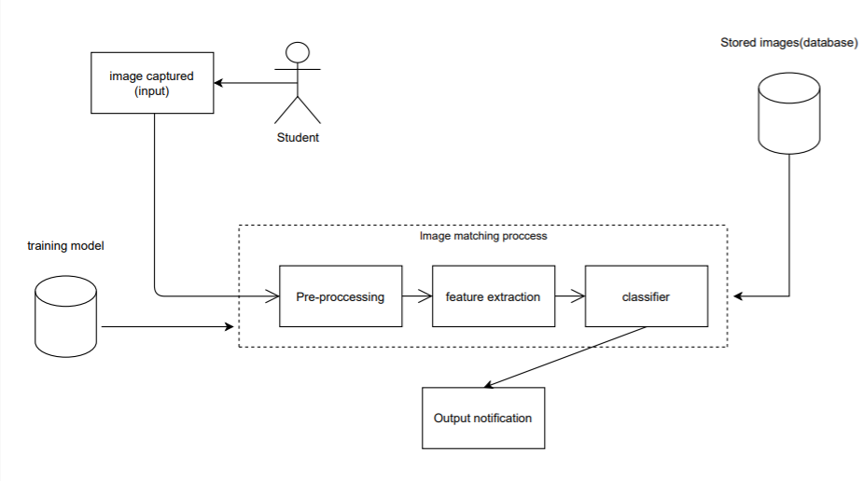
Implementation

Slide 11
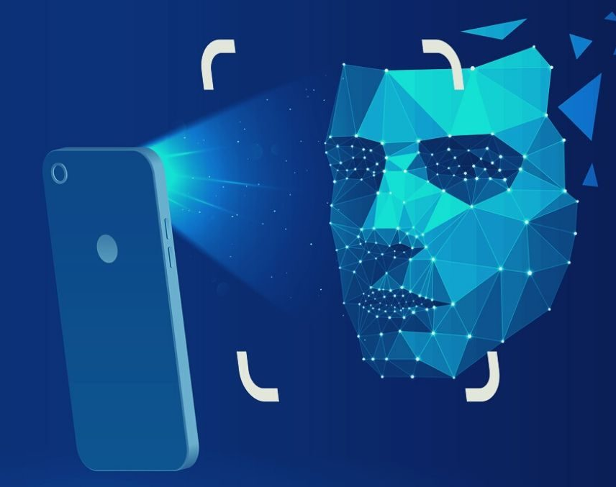
Attendance system

Slide 12
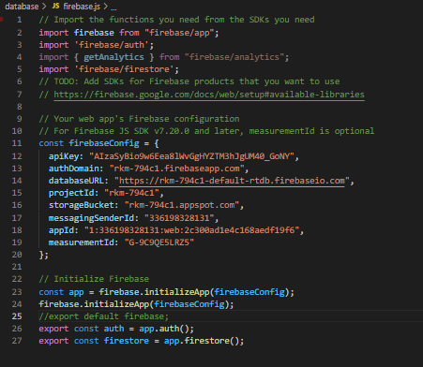
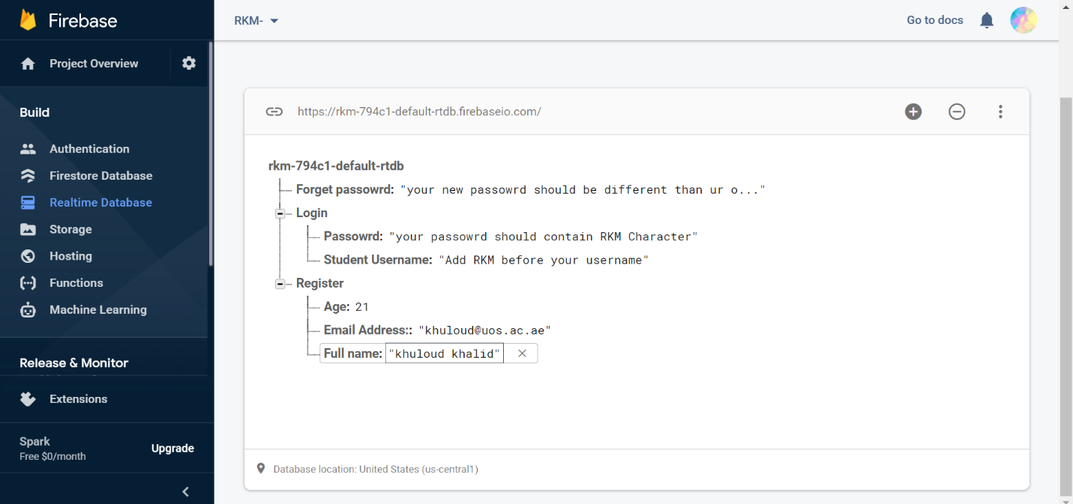
Database Set Up

Slide 13
IDE’s, Tools and Technologies
AWS Rekognition API
Android Studio: It consists of all Android SDK tools to design, develop, maintain, test, debug and publish our app.
Android Software Development Kit (SDK)
Visual studio code
Java SE Development Kit (JDK)
Expo Cli quickstart
NPM Package manager
Node.js 12
Android Virtual Devices (AVDs)

Slide 14
Languages used
React Native
Javascript
Node.js

Slide 15

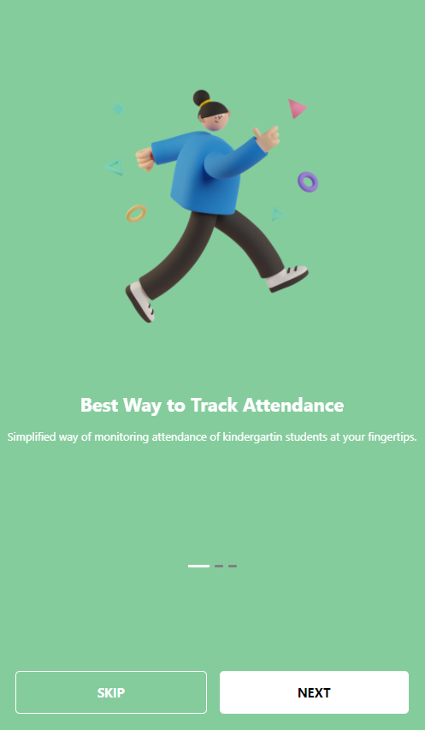

User Interface (React Native)

Slide 16
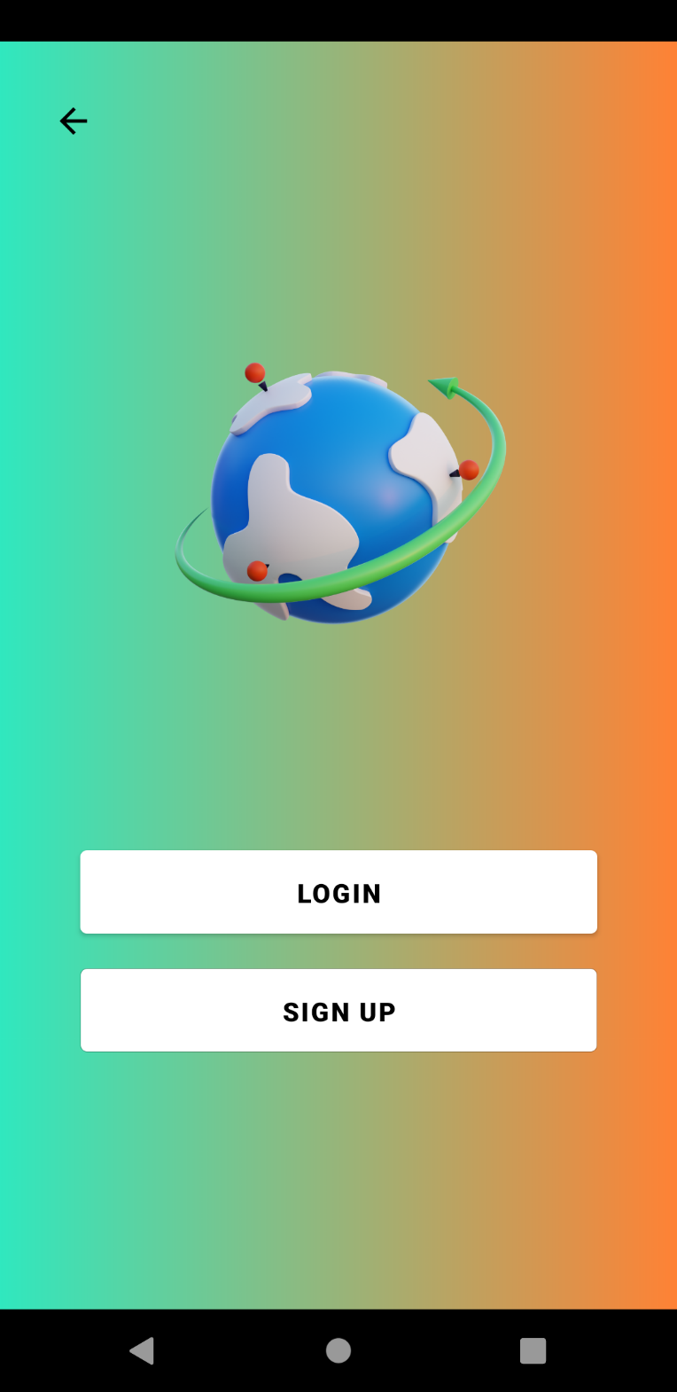
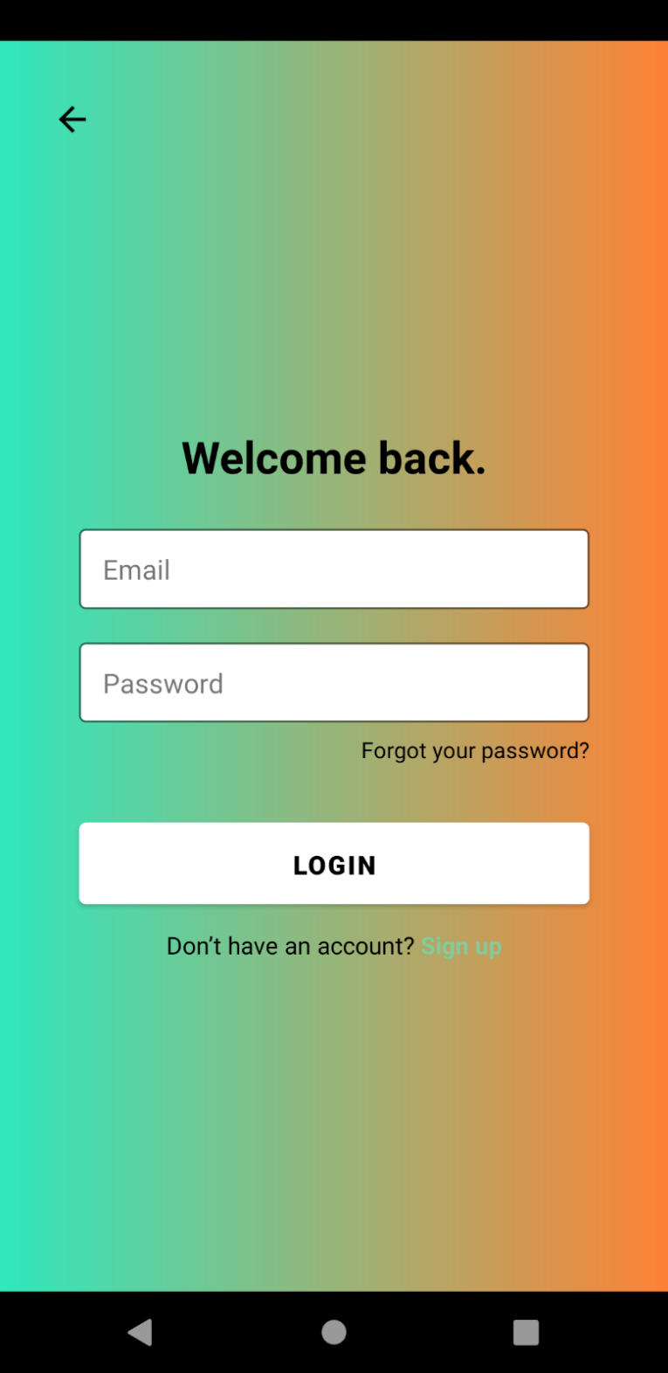
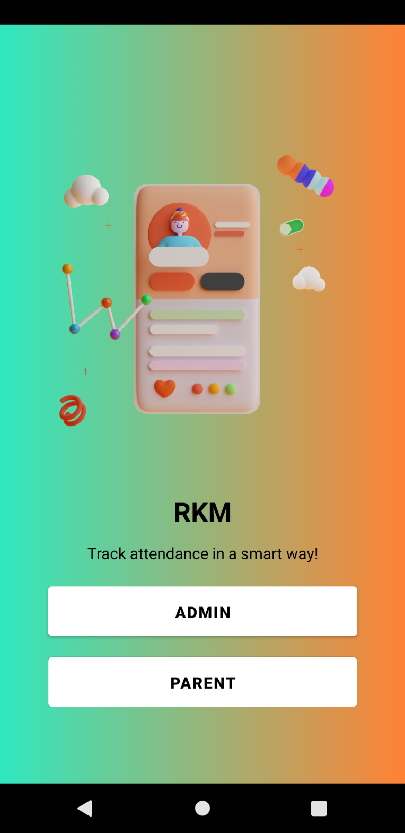

Slide 17
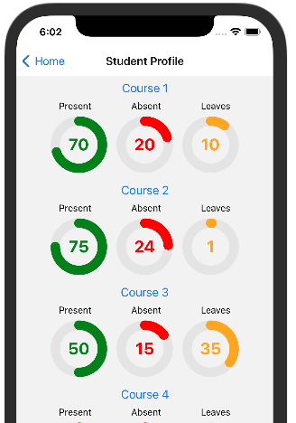
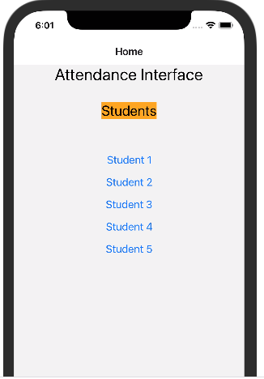

Slide 18

Facial Recognition Set Up

Slide 19
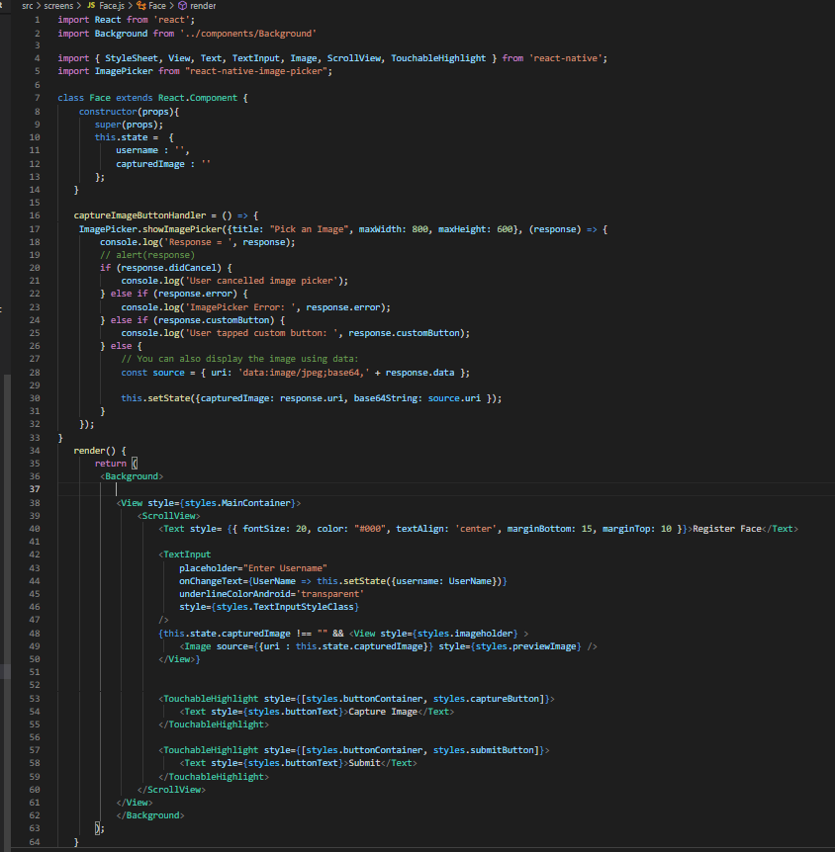
Code Examples

Slide 20
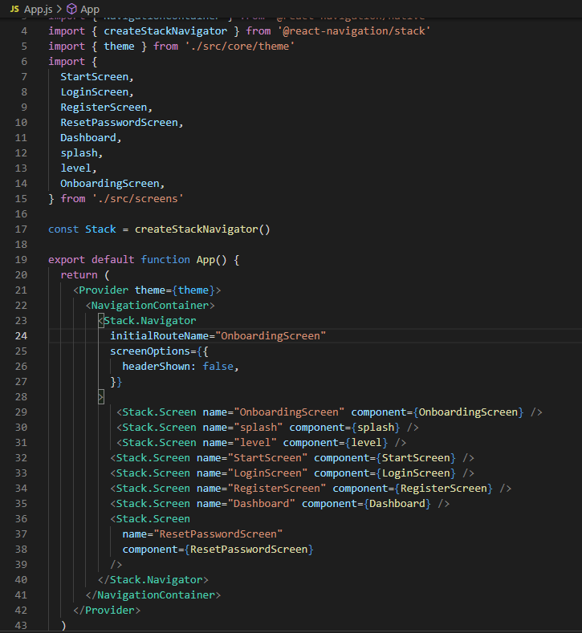

Slide 21
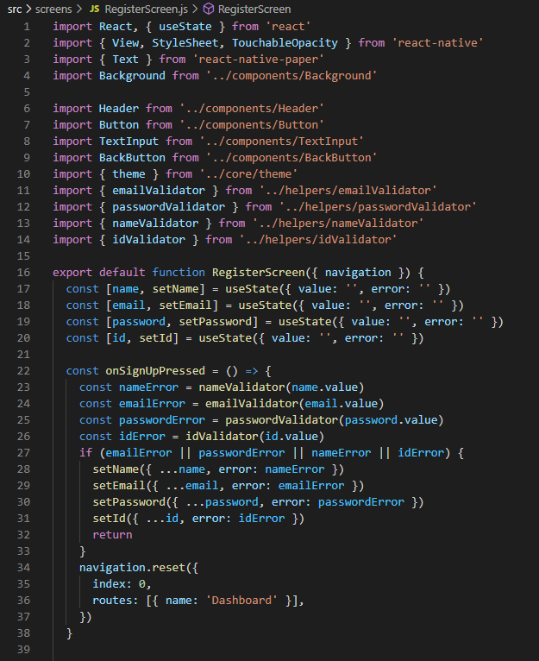

Slide 22
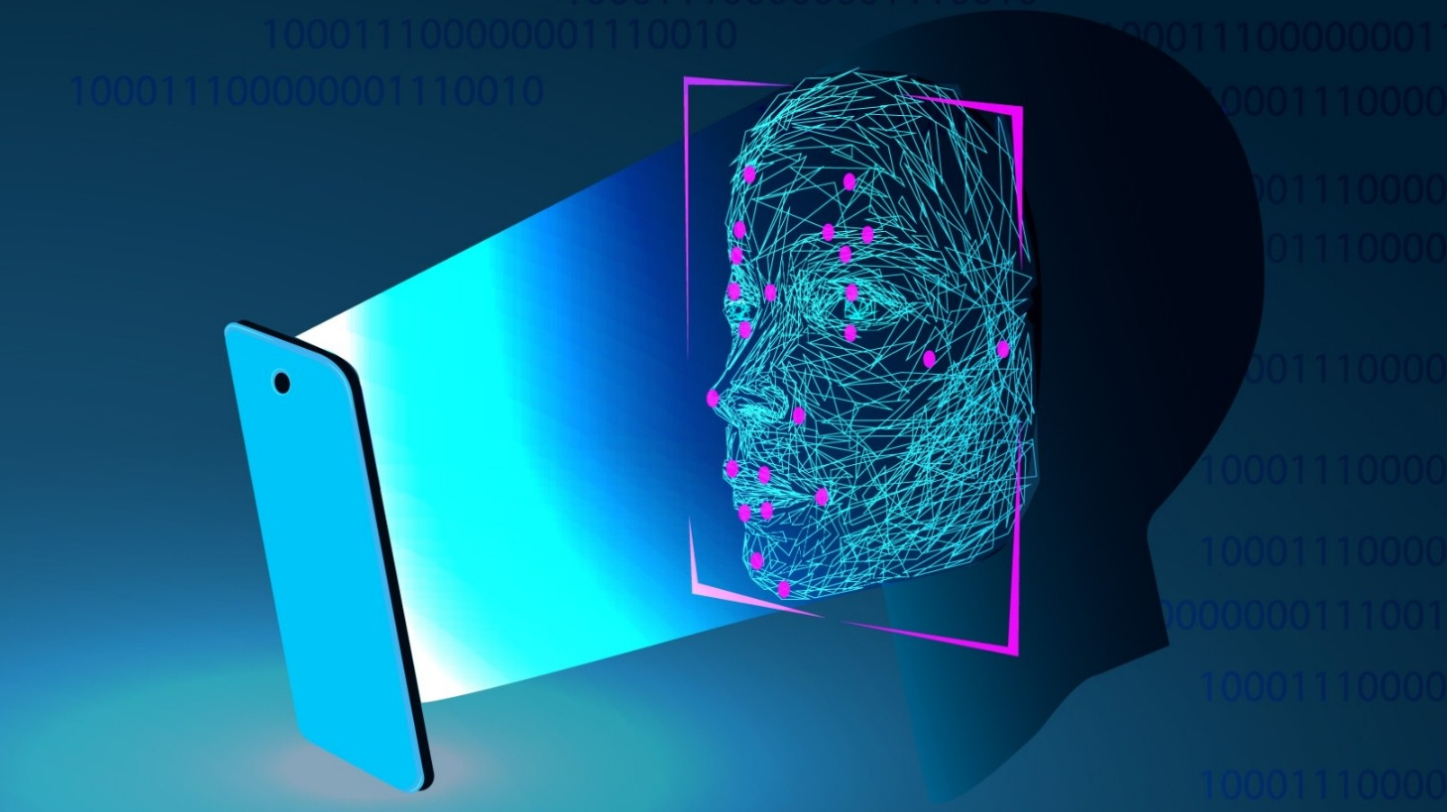
Conclusion and Results

Slide 23

Thank You

Slide 24
References
[13] Engineering@ZenOfAI. (2020, January 20). Face Recognition App In React Native using AWS Rekognition. Retrieved November 11, 2021, from ZenOf.AI website: https://medium.com/zenofai/face-recognition-app-in-react-native-using-aws-rekognition-c10b188a6413
[14] How to Create a Face Detection App With React Native. (n.d.). Retrieved from Code Envato Tuts+ website: https://code.tutsplus.com/tutorials/how-to-create-a-face-detection-app-with-react-native--cms-26491

